Slide 1

M O N T E N E G R O
Negotiating Team for the Accession of Montenegro to the European Union
Working Group for Chapter 10 – Information society and media
Bilateral screening: Chapter 10
PRESENTATION OF MONTENEGRO
Brussels, 21-22 January 2013

Slide 2
Chapter 10: Information society and media
DIGITAL AGENDA FOR EUROPE
Ružica Mišković
Adviser for European Integration and International Cooperation
Ministry for Information Society and Telecommunication
ruzica.miskovic@mid.gov.me
M O N T E N E G R O
Negotiating Team for the Accession of Montenegro to the European Union
Chapter 10: INFORMATION SOCIETY AND MEDIA

Slide 3
Background
Chapter 10: Information society and media
Europe 2020 Strategy1, launched in March 2010
One of the seven flagship initiatives of the Europe 2020 Strategy
Objective, to maximise the social and economic potential of ICT
M O N T E N E G R O
Negotiating Team for the Accession of Montenegro to the European Union
Chapter 10: INFORMATION SOCIETY AND MEDIA

Slide 4
Content
Chapter 10: Information society and media
Strategy for Information Society Development
Broadband
M O N T E N E G R O
Negotiating Team for the Accession of Montenegro to the European Union
Chapter 10: INFORMATION SOCIETY AND MEDIA

Slide 5
Strategy for Information Society development
Montenegro - digital society
Chapter 10: Information society and media
Adopted in December 2011.
For period 2012. to 2016.
Five pillars of development
Information society development, Electronic communication strategy, Broadband strategy
Action Plan
M O N T E N E G R O
Negotiating Team for the Accession of Montenegro to the European Union
Chapter 10: INFORMATION SOCIETY AND MEDIA

Slide 6
Five Pillars of Development
Chapter 10: Information society and media
ICT sustainablity
ICT for community
ICT for public administration
ICT for economic development
Development of media and broadcasting market
M O N T E N E G R O
Negotiating Team for the Accession of Montenegro to the European Union
Chapter 10: INFORMATION SOCIETY AND MEDIA

Slide 7
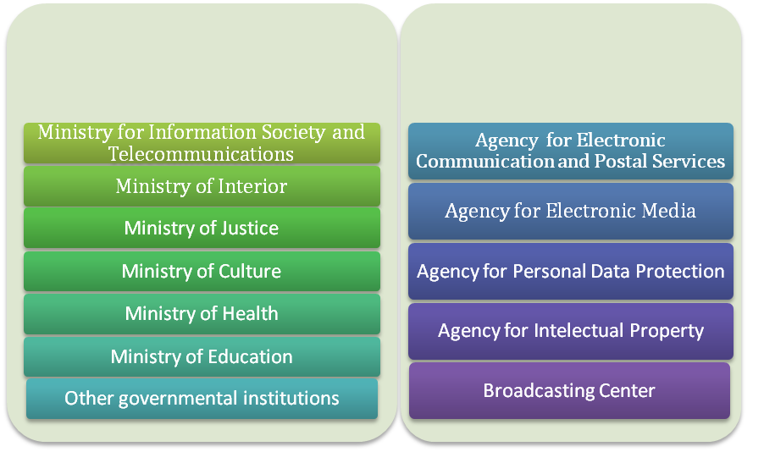
Institutional Framework
Chapter 10: Information society and media
M O N T E N E G R O
Negotiating Team for the Accession of Montenegro to the European Union
Chapter 10: INFORMATION SOCIETY AND MEDIA

Slide 8
Adopted Laws
Chapter 10: Information society and media
Law on Electronic Communication
Law on Electronic Commerce
Law on Electronic Signature
Law on Electronic Media
Law on Electronic Document
Law on Information Security
Law on Personal Data Protection
Copyright and Related Rights Law
Law on application of legal acts for protection of intellectual property rights
Digital Broadcasting Law
Law on confirmation of Convention on Cyber crime
...
M O N T E N E G R O
Negotiating Team for the Accession of Montenegro to the European Union
Chapter 10: INFORMATION SOCIETY AND MEDIA

Slide 9
Action Plan
Chapter 10: Information society and media
Adopted Law on Electronic Communication
Adopted Amended Law on Electronic Commerce.
Established Disaster Recovery Center
Implemented National CIRT
Implemented Portal e-Government
Fully implemented Electronic Document Management System
Permanent Promotion of Information Society Development
Improved education system in ICT development
ICT for marginalized groups
Organized workshops, trainings, seminars, round-tables
Other activities
M O N T E N E G R O
Negotiating Team for the Accession of Montenegro to the European Union
Chapter 10: INFORMATION SOCIETY AND MEDIA

Slide 10
Chapter 10: Information society and media
Broadband
M O N T E N E G R O
Negotiating Team for the Accession of Montenegro to the European Union
Chapter 10: INFORMATION SOCIETY AND MEDIA

Slide 11
Broadband strategy
Chapter 10: Information society and media
Achieve mass acceptance of ICT and the Internet;
Improve digital inclusion;
Reach the level of:
- use of the Internet of 70% by 2014 and 80% by 2016
- broadband access – of 25% by 2014 and 40% by 2016
Raise the possibility of broadband access that is high-speed access by providing a symmetrical, guaranteed access to broadband (agnostic approach) of at least:
- 10 Mbps for 50% of the population by 2014
- 10 Mbps for 100% of the population, and 30Mbps for 50% of the population by 2016
M O N T E N E G R O
Negotiating Team for the Accession of Montenegro to the European Union
Chapter 10: INFORMATION SOCIETY AND MEDIA

Slide 12
Fixed broadband market
Chapter 10: Information society and media
Increase for 13.7% comparing with october 2011.
Increase for 152% comparing with 2009.
M O N T E N E G R O
Negotiating Team for the Accession of Montenegro to the European Union
Chapter 10: INFORMATION SOCIETY AND MEDIA

Slide 13
Penetration of xDSL access by municipalities
Chapter 10: Information society and media
Large differences in the penetration
Between the largest and the smallest difference about 7 times
Should pay special attention to overcome this "broadband" gap
M O N T E N E G R O
Negotiating Team for the Accession of Montenegro to the European Union
Chapter 10: INFORMATION SOCIETY AND MEDIA

Slide 14
Chapter 10: Information society and media
Fixed broadband access
Penetration is significantly lower than the EU average;
The largest number of xDSL connections;
A significant number of installed terminals FTTx lines - 10% of the fixed cable connections;
A significant increase in the number of FTTx subscribers.
M O N T E N E G R O
Negotiating Team for the Accession of Montenegro to the European Union
Chapter 10: INFORMATION SOCIETY AND MEDIA

Slide 15
Mobile broadband access
Chapter 10: Information society and media
2011. is almost twice as high comparing with 2010.
Higher than the regional average;
Higher than the EU average;
UMTS/HSDPA/HSPA+/LTE
M O N T E N E G R O
Negotiating Team for the Accession of Montenegro to the European Union
Chapter 10: INFORMATION SOCIETY AND MEDIA

Slide 16
Mobile broadband access
Chapter 10: Information society and media
The high level of penetration - above the EU average
The range of the digital dividend (790-862 MHz)
Free to mid 2015/digitizing broadcasting
M O N T E N E G R O
Negotiating Team for the Accession of Montenegro to the European Union
Chapter 10: INFORMATION SOCIETY AND MEDIA

Slide 17
Thank you for your attention.
QUESTIONS

