Slide 1

M O N T E N E G R O
Negotiating Team for the Accession of Montenegro to the European Union
Working Group for Chapter 10 – Information society and media
Bilateral screening: Chapter 10
PRESENTATION OF MONTENEGRO
Brussels, 21-22 January 2013

Slide 2
SWITCH OFF OF ANALOGUE TERRESTRIAL BROADCASTING
Chapter 10: Information society and media
Ljiljana Bracanović Nikolić
Head of R&D and Transmission Systems Broadcasting Center
ljiljab@rdc.co.me
M O N T E N E G R O
Negotiating Team for the Accession of Montenegro to the European Union
Chapter 10: INFORMATION SOCIETY AND MEDIA

Slide 3
Chapter 10: Information society and media
Relevant Acquis
Commission Communication on Accelerating the transition from analogue to digital broadcasting - COM(2005) 204 52005DC0204
Commission Communication on the transition from analogue to digital broadcasting (from digital 'switchover' to analogue 'switch-off') - COM(2003) 541 52003DC054
M O N T E N E G R O
Negotiating Team for the Accession of Montenegro to the European Union
Chapter 10: INFORMATION SOCIETY AND MEDIA

Slide 4
National Legislation
Chapter 10: Information society and media
Law on Digital Broadcasting
("Official Gazette of Montenegro", no. 34/11 ,and 31/12)
Law on Electronic Communications ("Official Gazette of Montenegro", no.50/08, 53/09, 70/09, 40/10, 49/10, 32/11 and 40/11)
Law on Electronic Media
("Official Gazette of Montenegro", no. 46/10, 73/10 and 40/11)
PSB Law (RTCG Law)
("Official Gazette of Montenegro", no. 79/08 and 45/12)
Digital switchover strategy of Montenegro
(Broadcasting Agency , Ref.no. 01-786)
Allotment plan for digital broadcasting
("Official Gazette of Montenegro", no. 55/11)
M O N T E N E G R O
Negotiating Team for the Accession of Montenegro to the European Union
Chapter 10: INFORMATION SOCIETY AND MEDIA

Slide 5
Chapter 10: Information society and media
What we have done so far?
2004 - 2006
  The Broadcasting Agency of Montenegro started process in 2004;
  RRC-04 and RRC-06 and all preparatory activities including international coordination between this sessions of the RRC Conference in Geneva;
  2006 - 2008
  Many promotional activities of digital television networks and services and preparation of switchover strategy;
  Digital Switchover Strategy was adopted, April 2008, and first steps to IPA co-founded project have been done;
  2009 - present
  - Regulatory framework for electronic communications has been changed, August 2009;
  Law on Digital Broadcasting, adopted in July 2011; Frequency Allotment Plan for Digital Broadcasting, adopted in November;
  Law on Digital Broadcasting has been amended, June 2012; Deadline for analogue switch-off,
  changed to 17 June 2015;
M O N T E N E G R O
Negotiating Team for the Accession of Montenegro to the European Union
Chapter 10: INFORMATION SOCIETY AND MEDIA
Notes:
5

Slide 6
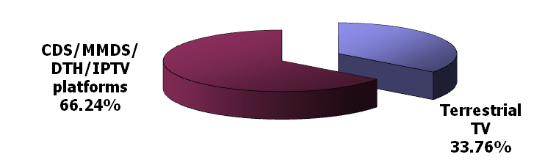
Chapter 10: Information society and media
Market information
Total number of citizens 625.200
TV households: 194.700
Market share:
  Terrestrial: 33,6 %
  Alternative platforms 66,24 %
Terrestrial broadcasters:
Radio Television Montenegro (public service broadcaster with 3 channels),
3 comercial TV broadcasters with national coverage
14 regional/local services
3 local PSB services
Major terrestrial network operator: Broadcasting center ltd
M O N T E N E G R O
Negotiating Team for the Accession of Montenegro to the European Union
Chapter 10: INFORMATION SOCIETY AND MEDIA

Slide 7
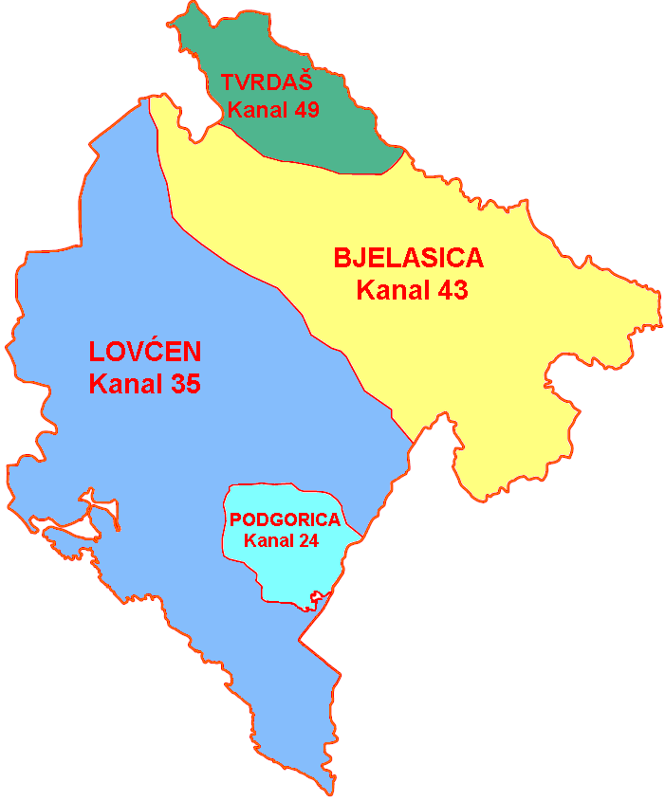
Commission Communication-COM(2003)541 -ANNEX2 Strategic plan for switchover
Chapter 10: Information society and media
The Frequency Allocation Plan for digital broadcasting - contained in the GE06 Agreement and existing Allotment plan
DVB-T2 plan with:
    7 national coverage in the UHF band &
    1 national coverage in the VHF band
National coverage: 3 allotment, 1 sub-allotment
A /V parameters
MPEG-4 – AVC HP@L3 high profile video
MPEG-1 layer 2 AAC/HECC
Planned target market: fixed roof for all, and portable outdoor for urban area
Target date for digital switch-on, 17 June 2015
M O N T E N E G R O
Negotiating Team for the Accession of Montenegro to the European Union
Chapter 10: INFORMATION SOCIETY AND MEDIA

Slide 8
Commission Communication-COM(2003)541 -ANNEX2
Chapter 10: Information society and media
Policy objectives-Article 9 (DB low)
For the purpose of digital broadcasting of signals of the national broadcasting services, Radio Television of Montenegro is awarded the right to access the first network multiplex with coverage of the entire territory of Montenegro, without conducting public call procedure, for transmission of two television programs in the standard quality (SDTV).
Spectrum management-Article 3
Network planning for digital terrestrial broadcasting shall be carried out in accordance with the Plan for Allocation of Radio-Frequencies for Digital Terrestrial Broadcasting
The Allocation Plan shall provide for the technical requirements and the method of using individual radio-frequencies and geographic areas.
Allotment Plan for digital terrestrial broadcasting issued by Agency for Electronic communication and postal determine:
(a) technical terms and conditions of use of radio frequencies Allocation of radio frequency spectrum in Montenegro are intended for use by terrestrial digital broadcasting systems,
(b) the geographic areas (zones Allotment) to cover the digital broadcast signal.
M O N T E N E G R O
Negotiating Team for the Accession of Montenegro to the European Union
Chapter 10: INFORMATION SOCIETY AND MEDIA

Slide 9
Commission Communication-COM(2003)541 -ANNEX2
Chapter 10: Information society and media
Policy obligations and incentives - Article 10
For the purpose of providing conditions for digital broadcasting of signals of the national public broadcasting services of the Radio and Television of Montenegro:
1) development of the first network will be carried out for coverage of the entire territory of Montenegro, that is at least for 85% of the population of Montenegro and
2) funds will be provided for coverage of the increased costs for electricity in the switchover period (simultaneous operation of analogue and digital terrestrial systems) for the first network operator.
The funds referred to in paragraph 1 of this Article shall be provided from the Budget of Montenegro and other sources of financing (donation of European Commission, loans and other).
M O N T E N E G R O
Negotiating Team for the Accession of Montenegro to the European Union
Chapter 10: INFORMATION SOCIETY AND MEDIA

Slide 10
Chapter 10: Information society and media
Current activities
South East Europe Transnational Cooperation Programme
Program co-funded by the European Union
  12 partners from 10 countries
  Partners from Montenegro: Agency for Electronic Media (AEM) and Agency for Electronic Communications and Postal Services (EKIP)
  Harmonization of the activities in the target SEE region related to introduction of Digital Broadcasting services:
    Speed-up the overall process of analogue switch-off in the region
    Maximize harmonization of the legislative and technical frameworks with the EU digitalization process and avoid policy, technology and market fragmentation
    Develop regional proposal for optimal use of freed frequency spectrum for new ICT broadband services
    Address the management of digital dividend
Deliverables of the project
  Legal framework
  Technical framework
    Technical basis for adoption of Montenegrin standards (MEST) for the purpose of implementation of digital terrestrial broadcasting systems - document to be proposed to Institute for Standardization of Montenegro (ISME)
    Analyses on digital dividend exploitation possibilities
  Economic framework
  Public awareness framework
  More information on www.see-digi.tv
M O N T E N E G R O
Negotiating Team for the Accession of Montenegro to the European Union
Chapter 10: INFORMATION SOCIETY AND MEDIA
Notes:
10

Slide 11
Thank you for your attention.
QUESTIONS

