Slide 1

M O N T E N E G R O
Negotiating Team for the Accession of Montenegro to the European Union
Working Group for Chapter 10 – Information society and media
Bilateral screening: Chapter 10
PRESENTATION OF MONTENEGRO
Brussels, 22 January 2013

Slide 2
Chapter 10: Information society and media
ELECTRONIC SIGNATURE FRAMEWORK
Jelena Mitrović
Advisor
Ministry of information society and telecommunication
jelena.mitrovic@mid.gov.me
M O N T E N E G R O
Negotiating Team for the Accession of Montenegro to the European Union
Chapter 10: INFORMATION SOCIETY AND MEDIA

Slide 3
Chapter 10: Information society and media
Contents
Legal framework
Harmonization with the EU Directive
Certification bodies
Projects
Supervision
Challenges and future activities
M O N T E N E G R O
Negotiating Team for the Accession of Montenegro to the European Union
Chapter 10: INFORMATION SOCIETY AND MEDIA

Slide 4
Chapter 10: Information society and media
Relevant Acquis
Directive 1999/93/EC of the European Parliament and of the Council of 13 December 1999 on a community Framework for Electronic Signature 31999L0093
Commission Decision 2000/709/EC of 6 November 2000 on the minimum criteria to be taken into account by Member States when designating bodies in accordance with Article 3(4) of Directive 1999/93/EC of the European Parliament and of the Council on a Community framework for electronic signatures [Official Journal L 289 of 16.11.2000]. 32000D0709
Commission Decision 2003/511/EC of 14 July 2003 on the publication of reference numbers of generally recognised standards for electronic signature products in accordance with Directive 1999/93/EC of the European Parliament and of the Council. 32003D0511
Proposal for a Regulation of the European Parliament and of the Council on electronic identification and trust services for electronic transactions in the internal market COM(2012) 238 final of 04.06.2012 2012/0146 (COD) 52012PC0238
M O N T E N E G R O
Negotiating Team for the Accession of Montenegro to the European Union
Chapter 10: INFORMATION SOCIETY AND MEDIA

Slide 5
Chapter 10: Information society and media
National Legislation
Law on electronic Signature
(Official Gazette of Montenegro 55/03, 31/05 and 41/10)
http://www.mid.gov.me/en/library/zakoni
Rulebook on the content and manner of keeping record and registry of certification services providers
(Official Gazette of Montenegro 71/10)
http://www.mid.gov.me/en/library/pravilnici
Rulebook on measures and procedures of certificates and data protecting related to the signatories
(Official Gazette of Montenegro 61/2011)
http://www.mid.gov.me/en/library/pravilnici
Regulations on measures of electronic signature and advanced electronic signature security
(Official Gazette of Montenegro 61/2011)
http://www.mid.gov.me/en/library/pravilnici
M O N T E N E G R O
Negotiating Team for the Accession of Montenegro to the European Union
Chapter 10: INFORMATION SOCIETY AND MEDIA

Slide 6
Chapter 10: Information society and media
eSignature framework
Law on electronic Signature (2003)
Law on Amendments to the Law on electronic Signature (2005)
Law on Amendments to the Law on electronic Signature (2010)
Law is harmonized with EU regulations
Two main roles of Law:
To define conditions under which electronic signatures are legally equal to handwritten signatures
To define which conditions must be met by Certification bodies that issue qualified certificates for verification of qualified electronic signatures.
Supervision - Ministry for Information Society and Telecommunications.
CEN Membership
FESA Membership
M O N T E N E G R O
Negotiating Team for the Accession of Montenegro to the European Union
Chapter 10: INFORMATION SOCIETY AND MEDIA

Slide 7
Chapter 10: Information society and media
Standards
ETSI (European Telecommunications Standards Institute)
ESI (Electronic Signatures and Infrastructures);
standards CEN/ISSS and documents CWA (CEN Workshop Agreement);
Standards EESSI SG (European Electronic Signatures Standardisation Initiative Steering Group)
documents IETF RFC (Request for Comments);
documents and recommendations of the company RSA Data Security PKCS (Public Key Cryptographic Standards);
Common Criteria (for Information Technology Security Evaluation) in section EAL (Evaluation Assurance Level);
American standards FIPS 140-1 (determined by the standardization body: National Institute of Standards and Technology - Federal Information Processing Standards), as well as standards FIPS 140-2.
M O N T E N E G R O
Negotiating Team for the Accession of Montenegro to the European Union
Chapter 10: INFORMATION SOCIETY AND MEDIA

Slide 8
Chapter 10: Information society and media
Definitions
Directive 1999/93/EC- Article 2
Definitions:
Electronic signature
Advanced electronic signature
Certification service provider
Etc.
Article 2
Advanced electronic signature must:
Be exclusively associated with the signatory;
Clearly identify the signatory;
Be created using means that a signatory can manage independently and that are exclusively under his supervision;
Contain direct correlation with the data to which it refers in a manner that unambiguously provides an insight to any amendment to the original data.
Article 8
M O N T E N E G R O
Negotiating Team for the Accession of Montenegro to the European Union
Chapter 10: INFORMATION SOCIETY AND MEDIA

Slide 9
Chapter 10: Information society and media
Market access
Directive 1999/93/EC- Article 3
Certification service provider does not need special permission to perform the services-Article 18
The competent administration authority shall enter certification service providers in records of certification service providers. Records must be public and kept in electronic form- Article 21
Certification service provider who entered the records, if proves that all conditions for delivery of services prescribed by this Law and regulations adopted under this Law are fulfilled, may require from the competent administration authority to enter it in the Register of accredited certification service providers - Article 22
Supervision of the certification service providers shall be done by the competent administration authority - Article 39
M O N T E N E G R O
Negotiating Team for the Accession of Montenegro to the European Union
Chapter 10: INFORMATION SOCIETY AND MEDIA

Slide 10
Chapter 10: Information society and media
Internal market principles
Directive 1999/93/EC- Article 4
The admission of an electronic document with electronic signature or advanced electronic signature may not be rejected only because it is in electronic form -Article 3
State administration body competent for information society, shall regulate:
Electronic signature and advanced electronic signature protection measures;
Signatory’s identity verification measures
Technical-technological procedures for creation of advanced electronic signature;
Conditions that means for creation of advanced electronic signature shall fulfill - Article 12
Certification services in Montenegro may be performed also by certification service providers that have head offices abroad.-Article 17
M O N T E N E G R O
Negotiating Team for the Accession of Montenegro to the European Union
Chapter 10: INFORMATION SOCIETY AND MEDIA

Slide 11
Chapter 10: Information society and media
Legal effects of electronic signatures
Directive 1999/93/EC- Artricle 5
Electronic signature’s validity may not be denied, nor may be rejected as the evidence solely because:
It is in electronic form;
It is not based on a qualified certificate;
It is not based on a qualified certificate issued by an accredited certification service provider;
It is not created by means for creation of advanced electronic signature.
Article 6
Advanced electronic signature, which can be verified on the basis of a qualified certificate, in relation to data in electronic form:
- Has the same legal force as manu propria signature, i.e. manu propria signature and stamp in relation to data in paper form;
Is acceptable as evidence in legal affairs.
Article 7
M O N T E N E G R O
Negotiating Team for the Accession of Montenegro to the European Union
Chapter 10: INFORMATION SOCIETY AND MEDIA

Slide 12
Chapter 10: Information society and media
Liability
Directive 1999/93/EC- Article 6
Certification service provider has duty to:
Ensure that every qualified certificate contains all necessary information regulated by this Law;
Conduct full verification of signatory’s identity;
Ensure accuracy and integrity of data entered in records of issued certificates;
etc
Article 30
Certification service provider that issues qualified certificates or guarantees for qualified certificates issued by other provider is liable for damage caused to the party who relied on that certificate, if:
Information that qualified certificate contains is not valid at the moment of its issuance;
The certificate does not contain all elements prescribed for qualified certificate;
The provider did not enable a signatory to, at the moment of issuance of the certificate, have data for creation of electronic signature that correspond to data for verification of electronic signature that are given
The certificate does not contain information on restrictions regarding the use
Certification service provider is not liable for the damage caused by the use of the certificate beyond restrictions, if these restrictions are clearly stated in the certificate.
Article 37
M O N T E N E G R O
Negotiating Team for the Accession of Montenegro to the European Union
Chapter 10: INFORMATION SOCIETY AND MEDIA

Slide 13
Chapter 10: Information society and media
International aspects
Directive 1999/93/EC- Article 7
Qualified certificates issued by certification service providers with head office in one of the Member States of the European Union have the same legal force as qualified certificates issued in the Montenegro.
Qualified certificates issued by providers of certification services with headquarters abroad, outside the European Union, shall have the same legal force as qualified certificates issued in Montenegro, provided that:
meets the requirements prescribed by this law for issuance of qualified certificates
local service provider or provider in Member State of European Union guarantees for such a qualified certificate;
bilateral or multilateral agreement;
meets the requirements established by regulations of European Union for issuance of qualified certificates
Member State of European Union guarantees for such a qualified certificate.
Article 17
M O N T E N E G R O
Negotiating Team for the Accession of Montenegro to the European Union
Chapter 10: INFORMATION SOCIETY AND MEDIA

Slide 14
Chapter 10: Information society and media
Data protection
Directive 1999/93/EC – Article 8
Certification service provider may collect personal data that are necessary for the issuance and maintenance of the certificate, directly from the signatory or indirectly with his/her clearly expressed consent.
Certification service provider, upon the request of the signatory, may enter signatory’s pseudonym in the certificate, instead of full name of the signatory.
Article 38
M O N T E N E G R O
Negotiating Team for the Accession of Montenegro to the European Union
Chapter 10: INFORMATION SOCIETY AND MEDIA

Slide 15
Chapter 10: Information society and media
Directive 1999/93/EC
Law on electronic signature
Requirements for qualified certificates- ANNEX I
Requirements for certification-service-providers issuing qualified certificates-ANNEX II
Requirements for secure signature-creation device-ANNEX III
Recommendations for secure signature verification -ANNEX IV
Article 13
Article 15
Article 10
Article 11
M O N T E N E G R O
Negotiating Team for the Accession of Montenegro to the European Union
Chapter 10: INFORMATION SOCIETY AND MEDIA

Slide 16
Chapter 10: Information society and media
Supervision
Article 39 – 41
Supervision of the certification service providers shall be done by the competent administration authority.
Supervision of the certification service providers in domain of collection, use and protection of personal data of signatories may be performed both, state and other authorities defined by the Law and other regulations governing the protection of personal data.
M O N T E N E G R O
Negotiating Team for the Accession of Montenegro to the European Union
Chapter 10: INFORMATION SOCIETY AND MEDIA

Slide 17
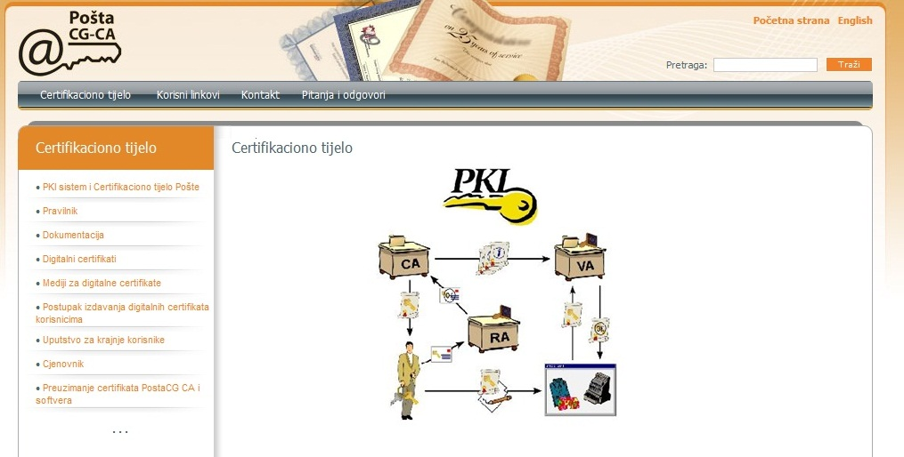
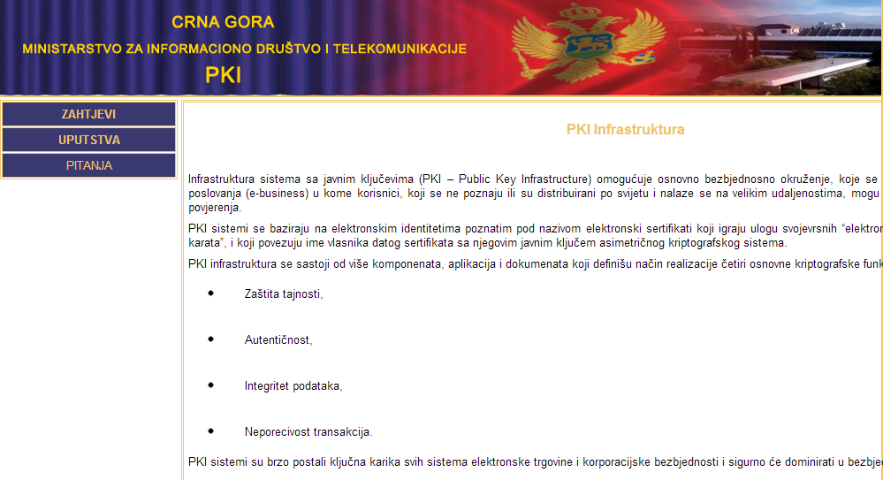
Chapter 10: Information society and media
Certification Bodies in Montenegro
Montenegro Post
http://www.postacg-ca.me
(PoštaCG-CA 2010)
3000 Ministry for Information Society and Telecommunications
www.pki.gov.me
(GOVME-CA 2009)
500
M O N T E N E G R O
Negotiating Team for the Accession of Montenegro to the European Union
Chapter 10: INFORMATION SOCIETY AND MEDIA

Slide 18
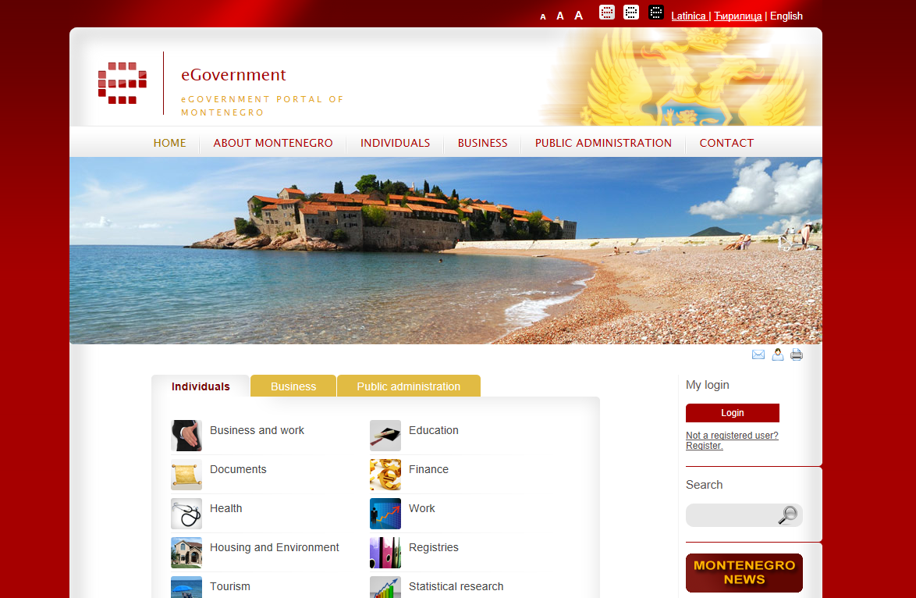
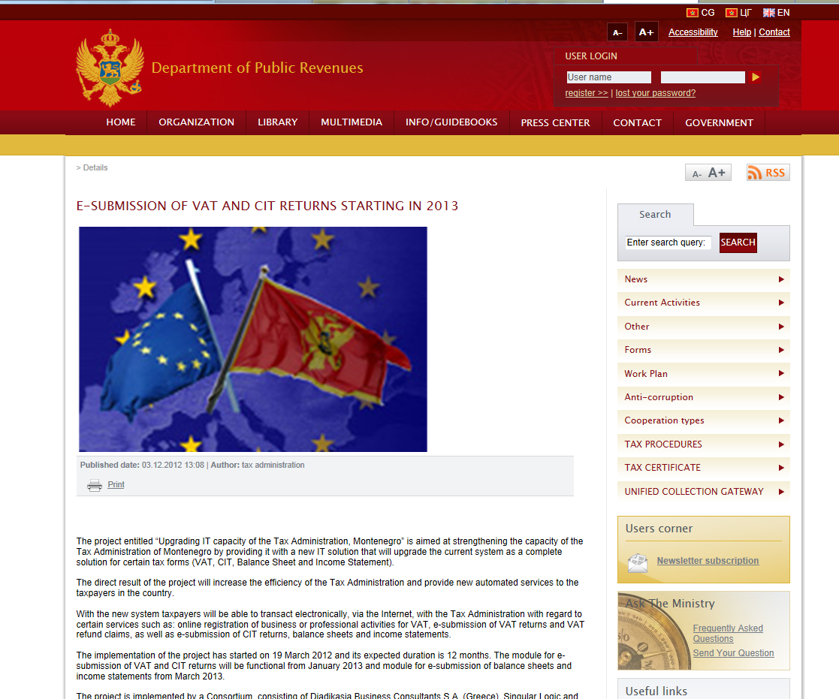
Chapter 10: Information society and media
On-going projects
E-Portal services
http://www.euprava.me/
Submission of payroll tax applications
E-submission of VAT and cit returns starting in 2013
http://www.poreskauprava.gov.me/uprava
M O N T E N E G R O
Negotiating Team for the Accession of Montenegro to the European Union
Chapter 10: INFORMATION SOCIETY AND MEDIA

Slide 19
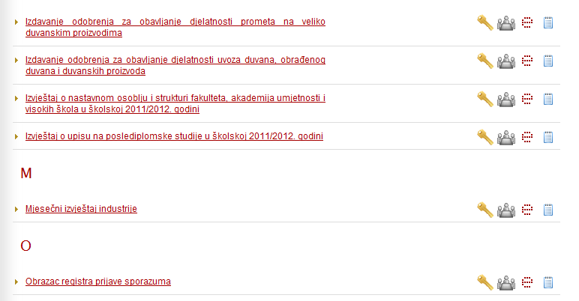
Chapter 10: Information society and media
ePortal Services
http://www.euprava.me/
M O N T E N E G R O
Negotiating Team for the Accession of Montenegro to the European Union
Chapter 10: INFORMATION SOCIETY AND MEDIA

Slide 20
Chapter 10: Information society and media
Challenges and Future Activities
Timestamp
National clock
Trust list
ETSI Membership
M O N T E N E G R O
Negotiating Team for the Accession of Montenegro to the European Union
Chapter 10: INFORMATION SOCIETY AND MEDIA

Slide 21
Thank you for your attention.
QUESTIONS

